Slide 1
Indoor Localization with Wi-Fi Fingerprinting
Mert Bayraktar

Slide 2
Indoor Localization
Indoor localization refers to the process of determining the location of an object or person inside a building or enclosed space using various technologies and techniques.
While GPS (Global Positioning System) is commonly used for outdoor positioning, it is often unreliable or inaccurate indoors due to signal attenuation and multipath effects caused by buildings and other structures.

Slide 3
Indoor Localization
Modeling of a particular building and the visual representation of its rooms.
Collecting Wi-Fi crowdsourcing data for radio map generation.
Room classification.

Slide 4
Fingerprinting
Usually requires an environmental survey to collect features of the environment (fingerprints) and then determine the location of the target by matching real-time measurements with the closest fingerprints stored in the database.
Fingerprint is a vector of statistical attributes of a signal received from multiple nodes, such as mean, variance, and histogram.

Slide 5
Fingerprinting
The fingerprinting technique consists of two stages: the offline stage and the online stage.
In the offline phase, a field survey in an environment or a signal propagation model should be used to create radio maps.
In the online stage, the localization algorithm uses the real-time signal vector and stored signal vectors in the database to estimate the device's location.
Notes:
A radio map is a database of known locations in an environment combined with radio signal characteristics such as RSS,
signal phase, propagation time, signal angles. The construction of the radio map begins with the division of the field into cells.
Signal vectors from APs are collected in these cells for a while and stored in the database

Slide 6
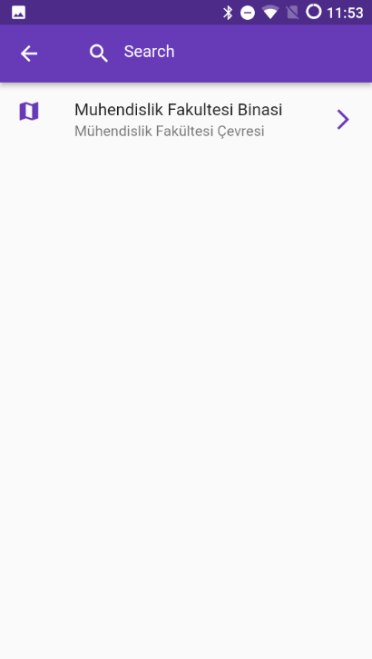

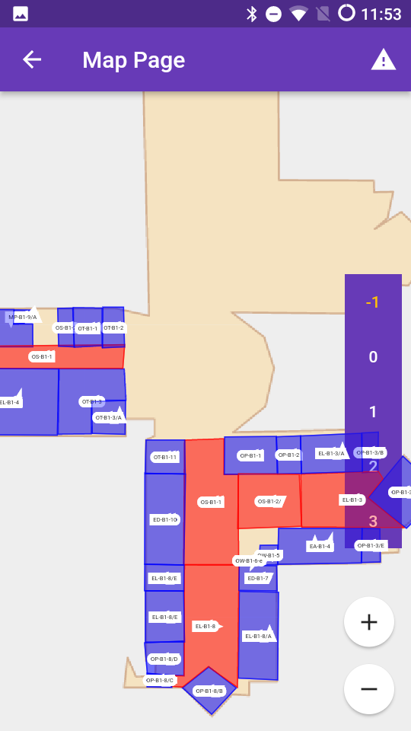

Slide 7
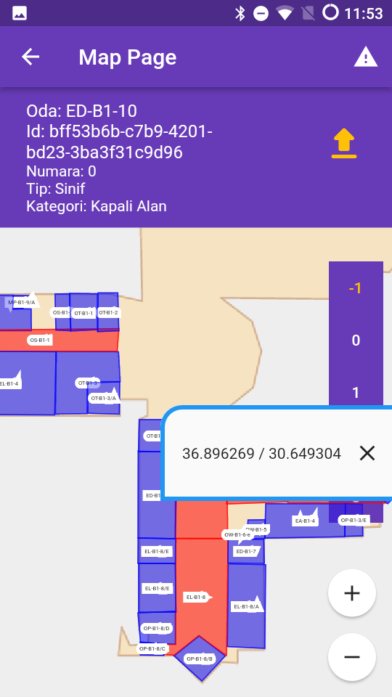
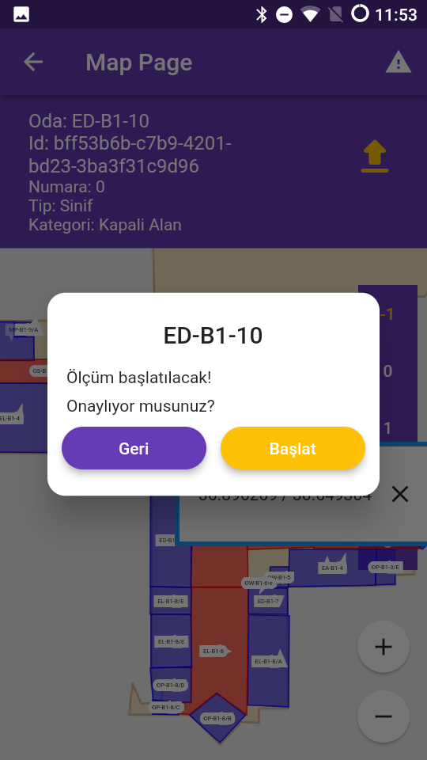
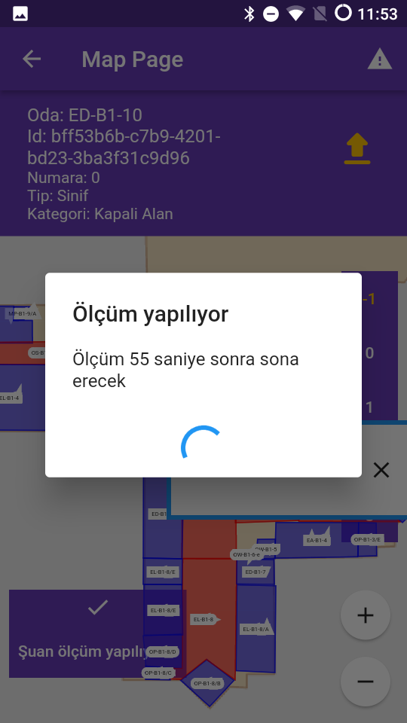
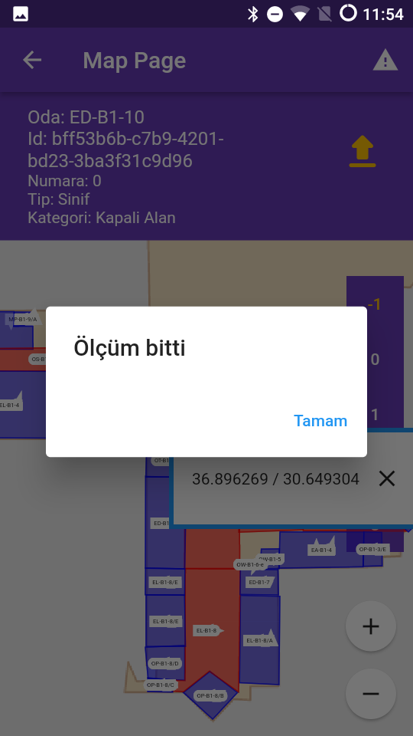
Mobile Application

Slide 8
Dataset
The dataset is provided as "csv" files to facilitate data manipulation, and no special software is required to read "csv" files. The 'csv' file consists of the following columns:
1. Coordinates: The three columns in the dataset show the GPS coordinates (latitude, longitude, and floor) of the classes where the measurements were made. Example: for a measurement in the dataset (x, y, z) = (36.89672737982672, 30.649524638866378, 1).
2. RSSI and Mac Address: There are 85 columns as all MAC addresses seen during the total measurement period. These columns are sorted numerically and alphabetically. In each line, the RSSI information received from the Wi-Fi access point with that MAC address is displayed in the data set. Each row corresponds to one measurement. Inaudible access points are set to 0 dBm. For example, in the dataset, the Wi-Fi access point with the MAC address “x” was heard at -66 dBm. RSSI values are interpolated between the timestamps of each measurement.
3. Timestamp: The timestamp column represents the interpolated timestamps of each measurement in UNIX time format. The timestamps provided are saved on a mobile device between the start and end times of each measurement.
4. Room: The room column shows the ID number of the room where the measurements were made. Data collection was done in the classrooms of the Engineering Faculty building, and these room identification numbers were entered before the measurements were taken in the mobile application. There are a total of 20 classrooms in the data set.

Slide 9
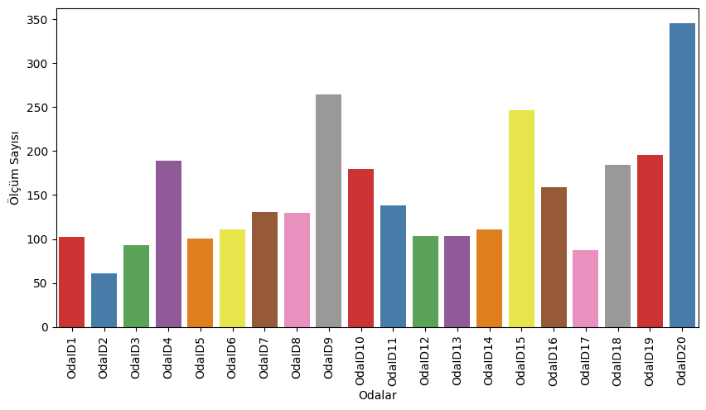
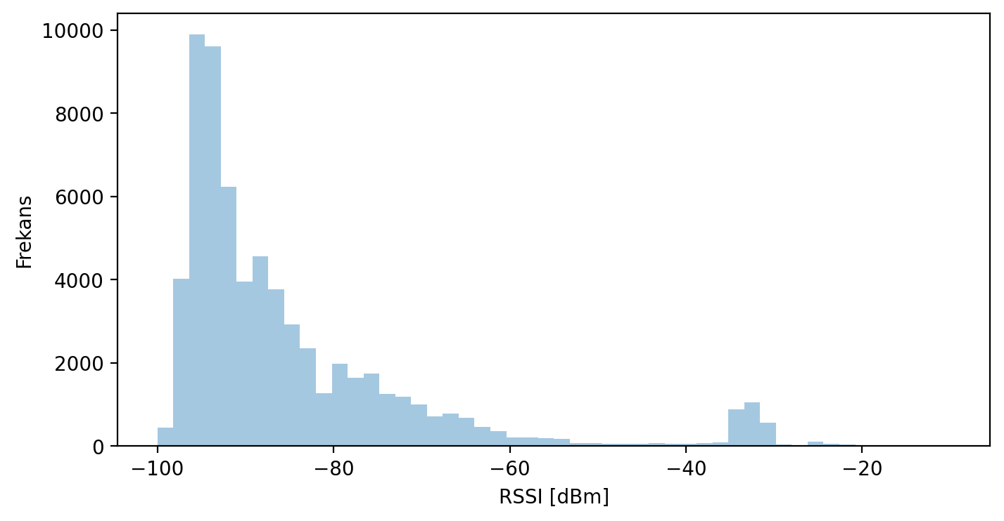
Notes:
The distribution of 3034 RSSI measurements made in 20 rooms according to the rooms is shown in left.
The number of rooms measured is 20, and the average number of measurements in the rooms is 152.
The highest measurement taken in a room is 345 and the lowest is 61 measurements.
The total number of detected RSSI values 65125 represents the values of the access points not seen during the measurement.
Assuming it was assigned as -1000, this number was seen as 257890. Figure 4.2 shows the RSSI distribution in the measured building.
As can be seen from this figure, the RSSI distribution is skewed to the left. While the majority of measurements are in
the -100 dBm and -80 dBm range, values in the -60 dBm and -20 dBm range are considered outliers.

Slide 10
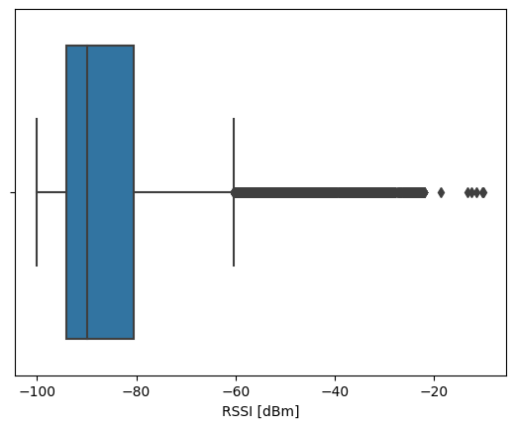
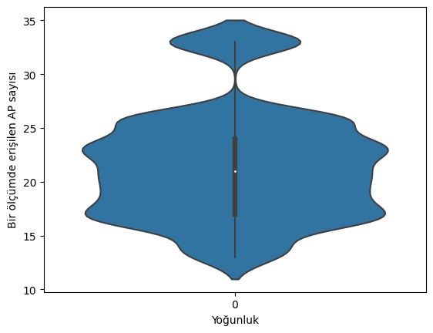
Notes:
Figure 4.3 shows the box plot of the measurements. According to this box chart,
the mean of the RSSI values was -84.61 dBm, and the standard deviation of the data was
15.004392. The lowest measured RSSI value is -100 dBm, the highest -9.99 dBm.
Q1 i.e. the first quarter represents the value below 25% of the data, this value is -94 dBm.
Q2, the second quartile, represents the middle value of the dataset when sorted in ascending order.
Accordingly, it is seen that 50% of the data falls below -90 dBm. Q3, the third quarter, represents the value
below 75% of the data, and this value was found to be -80.55 dBm. Values of -60 dBm and below are seen as discrete values.
Figure 4.4 shows a violin plot of access points accessed in a measurement.
According to this graph, the average number of access points accessed in one measurement was approximately 21,
and the standard deviation of the data was 5.042477. A minimum of 13 and a maximum of 33 access points were seen in one measurement.
According to the first quarter information, 25% of the measurements had 17 or less access points, according to the second quarter information,
21 or less access points were seen in 50% of the measurements, and 24 or less access points were found in 75% of the measurements.

Slide 11
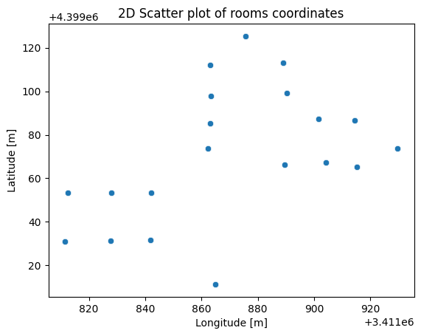
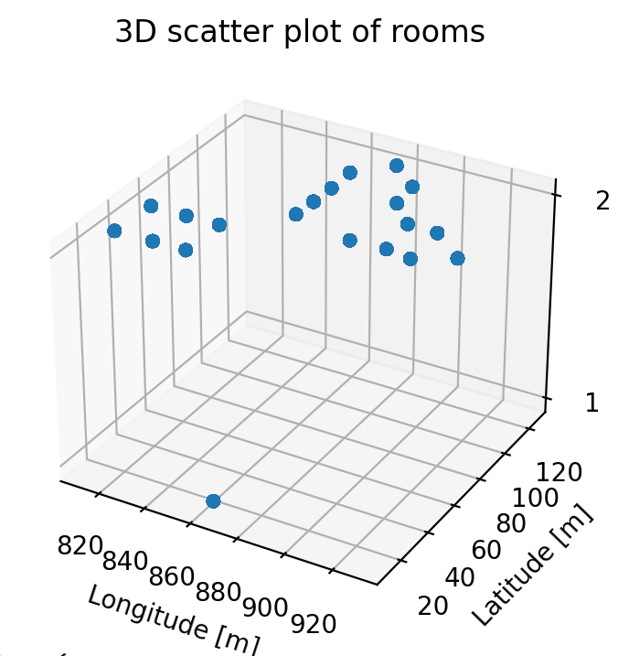

Slide 12
Simulation Overview
The simulation model consists of two types of agents: IndoorAgent and MobileAgent.
The IndoorAgents represent stationary elements in the indoor environment, such as access points or reference points.
The MobileAgents represent mobile devices whose location needs to be estimated. These agents interact and simulate the localization process within the environment.

Slide 13
Agents
The IndoorAgent is responsible for simulating the behavior of stationary elements in the indoor environment. Each IndoorAgent keeps track of the received signal strength indicator (RSSI) values from the MobileAgents. This information is vital for estimating the location of the MobileAgents.
The IndoorAgent calculates the RSSI values by determining the distance between itself and each MobileAgent. It utilizes a signal propagation model to calculate the RSSI based on the distance. These RSSI values are then stored for further use by the MobileAgents.

Slide 14
Agents
The MobileAgent represents a mobile device whose location needs to be estimated within the indoor environment. Each MobileAgent can move randomly within the environment, simulating the movement of a real mobile device.
In the simulation, the MobileAgent updates its position on the grid by randomly selecting a neighboring location to move to. After moving, it predicts its location using the RSSI values received from the IndoorAgents. By comparing the RSSI values and using a signal propagation model, the MobileAgent estimates its distance from each IndoorAgent and predicts its location accordingly.

Slide 15
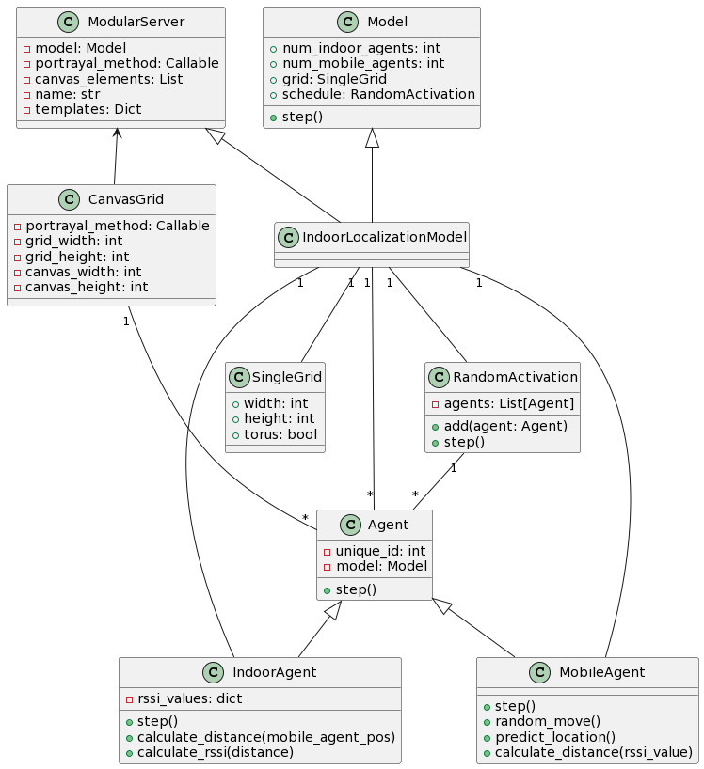
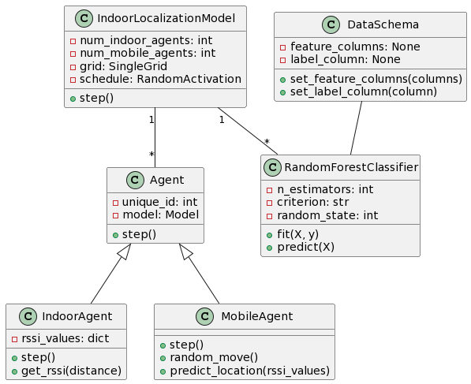
Notes:
Modular Server-Canvas Grid -> Association
1 - * > one to many relation
Indoor agent and mobile agent -> agent this inherits

Slide 16
Simulation Progress
The simulation progresses over time by executing the step function of each agent. The agents' steps are scheduled and managed by the Mesa library, which ensures the synchronization and interaction between the agents.
During each step, the IndoorAgents calculate the RSSI values from the MobileAgents based on their distances, and the MobileAgents update their positions and predict their locations based on the received RSSI values. This iterative process simulates the dynamic nature of the indoor localization process.

Slide 17
Simulation Model
The simulation model is visualized using the Mesa library's visualization capabilities. The grid visualization provides a visual representation of the indoor environment, with each agent represented by a specific shape and color.
In the visualization, the IndoorAgents are displayed as red rectangles, representing their stationary nature within the environment. The MobileAgents are represented as blue circles, symbolizing their mobility. Additionally, the current position of each MobileAgent is displayed as text within the visualization.

Slide 18
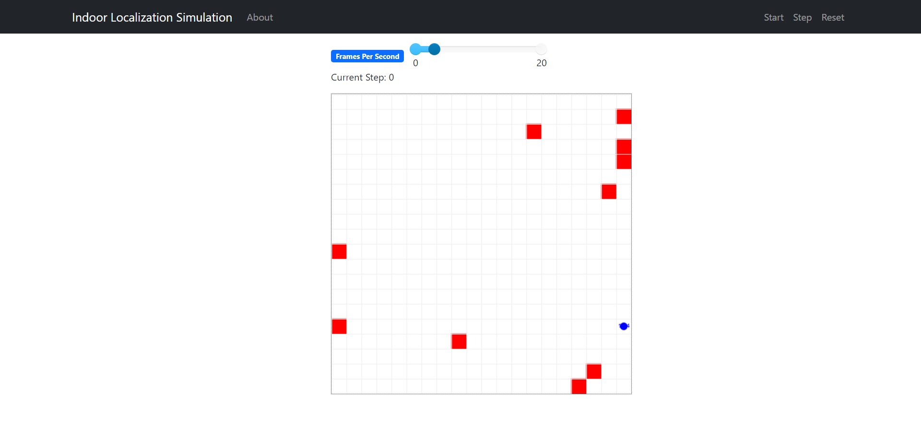


Slide 19
Benefits
Explicit Definition: The behaviors and interactions of the agents are explicitly defined within the simulation model, providing a clear understanding of the system dynamics.
Customization: The simulation model can be customized by adjusting parameters such as the number of agents and the size of the environment, allowing for tailored experiments and analysis.
Flexibility: The model-driven approach provides flexibility in incorporating various algorithms and techniques, enabling researchers to explore and compare different localization methods.

Slide 20
Conclusion
In this presentation, we have explored an indoor localization simulation using a model-driven approach. By simulating the behavior and interactions of IndoorAgents and MobileAgents, we can gain insights into the dynamics of indoor localization and optimize localization algorithms.
The simulation model, visualization, and demonstration have provided a practical understanding of how the model-driven approach can contribute to indoor localization research and development.

Slide 21
Future Work
Integrating Real-Time Data
While the presented model-driven approach provides valuable insights into indoor localization, incorporating real-time data into the simulation can further enhance its accuracy and practicality.
By integrating real-time data into the indoor localization simulation, we can bridge the gap between simulation and real-world scenarios, enabling more accurate analysis, optimization, and validation of localization algorithms.

Slide 22
Thank you for your attention!

